Slide 1
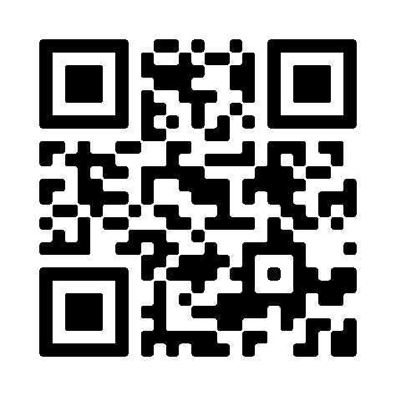
HURRY… SAVE UP TO 57%*
on a range of bikes!
*Savings based on a higher rate taxpayer saving 47% plus 20% discount.
Mountain Bikes | Hybrid Bikes | Road Bikes | E-Bikes Get an even better Cycle2Work deal on a range of bikes with an exclusive 20% discount. Make savings on top of savings. But hurry, 20% discount ENDS 31ST MARCH 2024
To see what bikes are available and for how to apply, scan the QR code
0345 504 64444
halfords.com/cycle2work
cycle2.work@halfords.co.uk
Halfords Ltd trading as Cycle2work is authorised and regulated by the Financial Conduct Authority (FCA FRN 724263)

